Slide 1
48 Hours Prototype Challenge
Telegram Chat Bot

Slide 2
Event Type
NUS_ISS Career Sharing – 100 attendees
Python FastAPI Workshop – 200 attendees

Slide 3
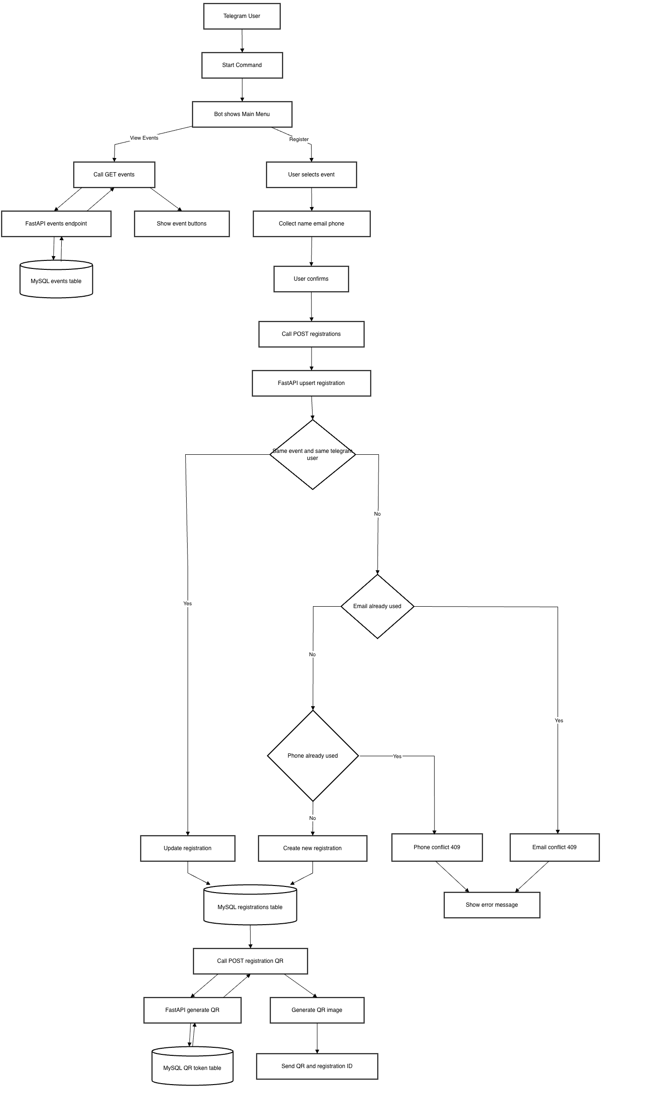

Slide 4
Assumptions
Pre-registration required
Smartphone access
Internet available

Slide 5
Technical Decisions
Use FastAPI
  Fast to build clean REST APIs
  Built-in request validation (Pydantic)
  Auto-generated Swagger documentation
Use Docker SQL
  No direct installation on the OS (Requires Docker)
  Very clean; easy to delete and remove at any time
  Easy (Change version by simply updating one line of code).
  Ensures an identical environment for every team member.

Slide 6
AI Collaboration
Tool used:
OpenCode (GPT-5.3-codex) as the main AI coding assistant for scaffolding, refactoring, API integration, and debugging.
Example where I changed AI output:
The initial API upsert logic allowed a different Telegram user to overwrite an existing registration when email + phone matched.
I revised it to match the business rule: only the same telegram_user_id can update their own registration, and email/phone stay unique per event (409 for conflicts).
Example where AI helped debugging:
During API startup, the app failed with ModuleNotFoundError: pymysql, then Access denied MySQL errors.
AI helped identify root causes (missing package + credential mismatch between .env and docker-compose.yml), fix them, and validate with endpoint smoke tests (/events, /registrations, /registrations/{id}/qr).

